Slide 1

Exploratory Analysis European League Football
Kaustubh Saha
Steven Tong
Raka Dhar
Joydip Dutta

Slide 2
Speakers
Data source, structure and cleanup- Raka
Feature analysis- Joydip
Factors and impact- Steven
Event Data analysis- Kaustubh

Slide 3
Objective
Explore the various features in the data and observe the trend in movement of those features across leagues or across years
Identify the features influencing the outcome of a match
Build a predictive model and test it

Slide 4
Data Source – League match
EPL : https://datahub.io/sports-data/english-premier-league LaLiga : https://datahub.io/sports-data/spanish-la-liga Serie A : https://datahub.io/sports-data/italian-serie-a BundesLiga : https://datahub.io/sports-data/german-bundesliga Ligue One : https://datahub.io/sports-data/french-ligue-1

Slide 5
Data Source – EU events
Kaggle (https://www.kaggle.com/secareanualin/football-events)

Slide 6
Structure of data- Match & Event
Date
HomeTeam
AwayTeam
FullTime_HomeTeam_Goals
FullTime_AwayTeam_Goals
FullTime_Result
HalfTime_HomeTeam_Goals
HalfTime_AwayTeam_Goals
HalfTime_Result
HomeTeam_Shots
AwayTeam_Shots
HomeTeam_ShotsOnTarget
AwayTeam_ShotsOnTarget
HomeTeam_FoulsCommitted
AwayTeam_FoulsCommitted
HomeTeam_Corners
AwayTeam_Corners
HomeTeam_YellowCards
AwayTeam_YellowCards
HomeTeam_RedCards
AwayTeam_RedCards
id_odsp
link_odsp
adv_stats
date
league
season
country
ht
at
fthg
ftag
odd_h
odd_d
odd_a
odd_over
odd_under
odd_bts
odd_bts_n

Slide 7
Data Load and Prep
Renamed columns to make it intuitive.
Changed index to date of match played.
Built a function to load data.
To begin with, we loaded one of the files and see if the data layout meets our expectations and followed the same approach for all the 5 of them and all of the data has similar structure.
Concatenated all league match data for each of the leagues including 2018-19 season which is still underway into a single data frame.

Slide 8
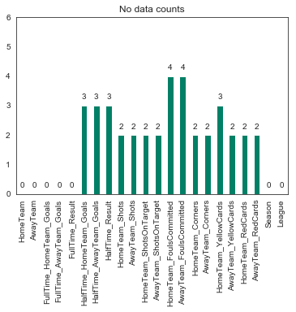
Data Cleansing
There were no duplicate records!
Missing records populated as follows-
Half time result was in line with full time result
Half time goals is half of full time goals.
Total number of shots on target is total number of goals.
Fouls, corners, red/yellow cards were taken as average of other matches for the same team.

Slide 9
Engineered Data
Winner : if FullTime_Result = 'H', then its Home Team. if FullTime_Result = 'A', then its Away Team. Else its null (implying draw)
Loser : if FullTime_Result = 'H', then its Home Team. if FullTime_Result = 'A', then its Away Team. Else its null (implying draw)
Total cards (Home Team) = Home Team yellow cards + Home Team red cards
Total cards (Away Team) = AT yellow cards + AT red cards
Total cards = Total cards (HT) + Total cards (AT)
% of shots on target (Home Team) = HT shots on target / HT total shots
% of shots on target (Away Team) = AT shots on target / AT total shots
Home team goal saves = AT shots on target – Full time AT goals
Away team goal saves = HT shots on target – Full time HT goals
Total Goals = Full time HT goals + Full time AT goals

Slide 10
Final data structure
HomeTeam
AwayTeam
FullTime_HomeTeam_Goals
FullTime_AwayTeam_Goals
FullTime_Result
HalfTime_HomeTeam_Goals
HalfTime_AwayTeam_Goals
HalfTime_Result
HomeTeam_Shots
AwayTeam_Shots
HomeTeam_ShotsOnTarget
AwayTeam_ShotsOnTarget
HomeTeam_FoulsCommitted
AwayTeam_FoulsCommitted
HomeTeam_Corners
AwayTeam_Corners
HomeTeam_YellowCards
AwayTeam_YellowCards
HomeTeam_RedCards
AwayTeam_RedCards
Season
League
Winner
Loser
TotalGoals
HomeTeam_TotalCards
AwayTeam_TotalCards
TotalCards
HomeTeam_ShotsOnTarget_Percent
AwayTeam_ShotsOnTarget_Percent
HomeTeam_GoalSaves
AwayTeam_GoalSaves

Slide 11
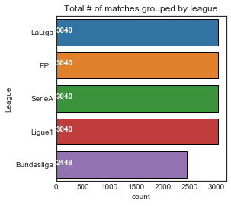
Total number of matches by League
2448
3040
Rest all
BundesLiga
Lets have a look at the number of matches per season per league. If its not uniform, then we might need to adjust the aggregate data accordingly before comparing (We'll ignore the current season as not every league starts at the same time)
Clearly Bundesliga has lesser number of matches as compared to other leagues.

Slide 12
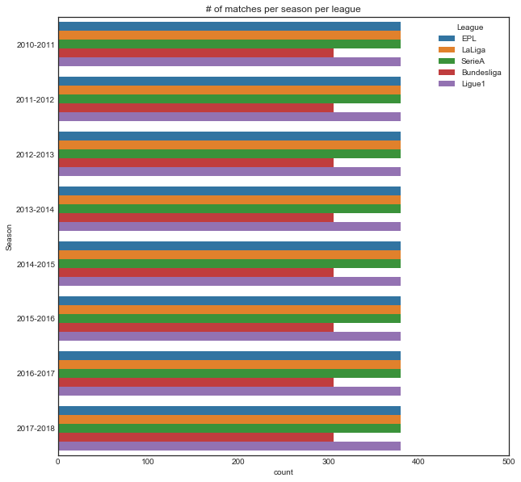
Team and number of matches
For a particular league, the number of matches per season has remained consistent over the years.
However when we compare other league aggregate data with Bundesliga, the data might need some adjustment.

Slide 13
BundesLiga data adjustment
Bundesliga has 18 teams and 306 games (34 games for each team) per season whereas other leagues have 20 teams and 380 games a season (38 games for each team)
Bundesliga has been scaled up accordingly in order to do a fair comparison wherever aggregate was compared across leagues
BUNDESLIGA_TEAM_SCALEUP = 38/34
BUNDESLIGA_SEASON_SCALEUP = 380/306

Slide 14
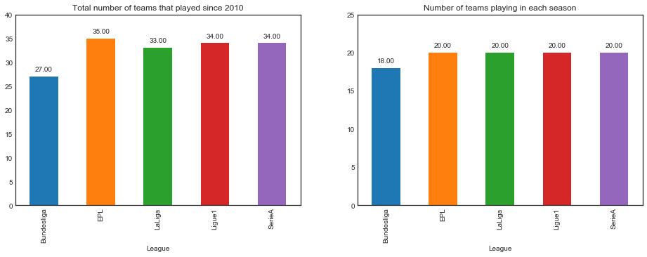
Feature analysis – Team and number of matches
The difference between the two numbers indicates that there were occasions where teams were relegated to lower tier league or top teams from lower tier leagues were promoted

Slide 15
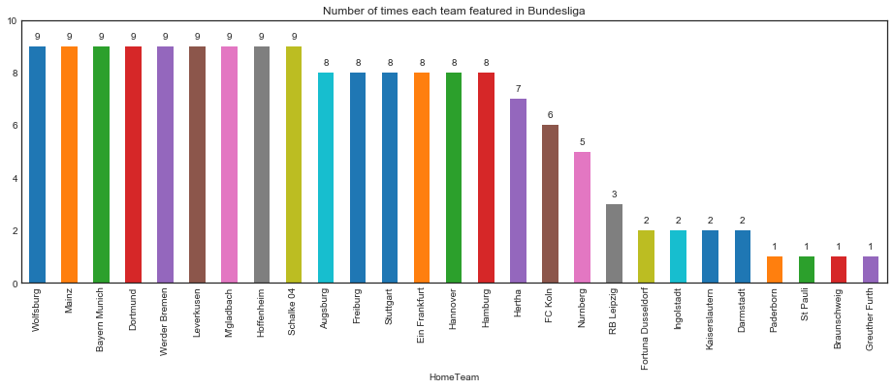
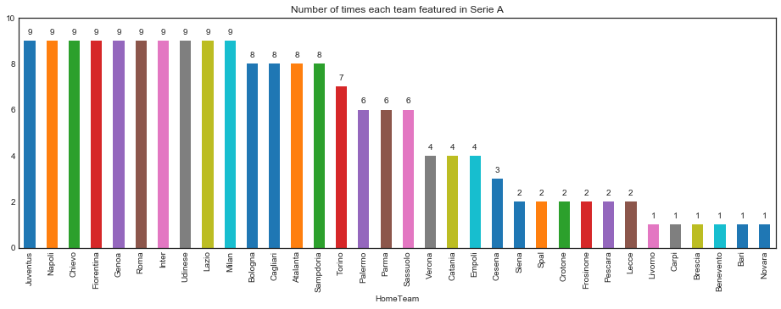
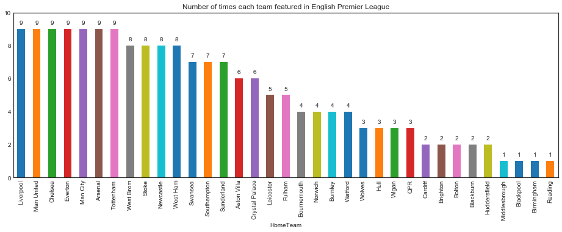
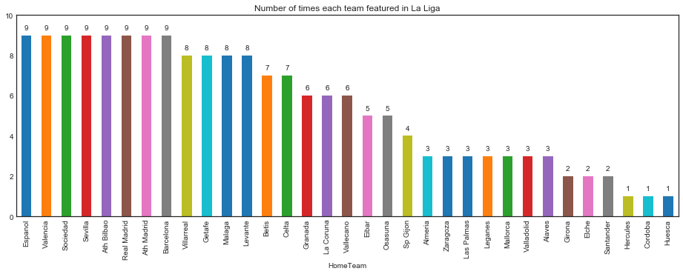
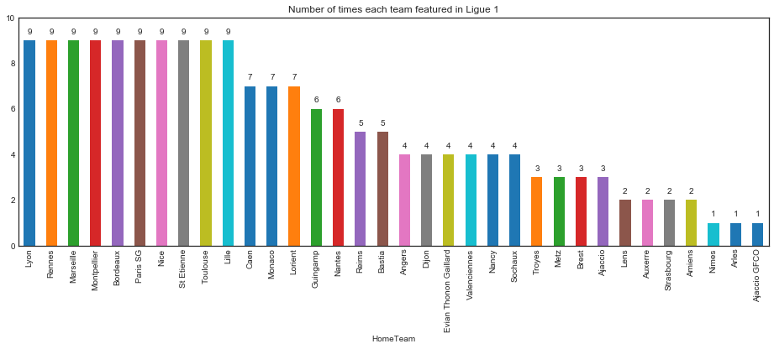
Feature analysis – Relegation

Slide 16
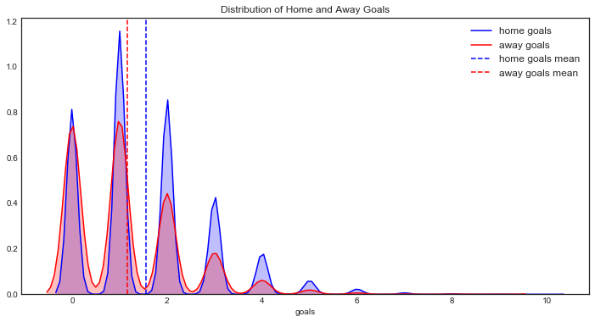
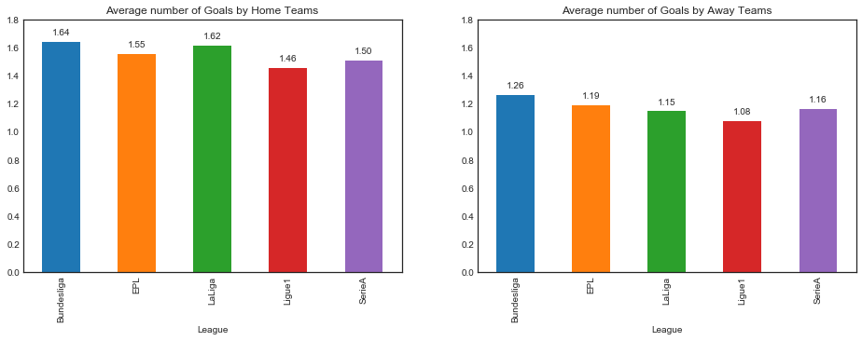
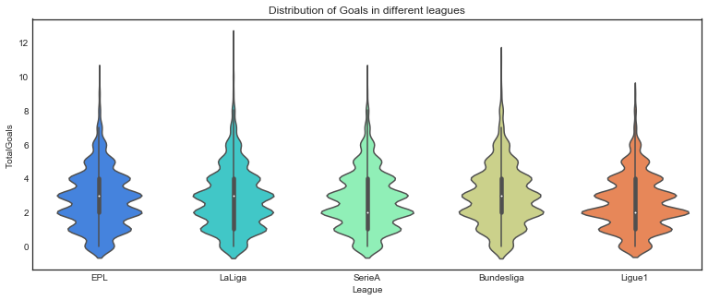
Feature analysis – Goals
The mean value for home goals is higher than that of away goals. So there might be some home advantage.
Total number of goals vary between 1 and 4. It's quite rare to see more than 6 goals in a match in any league

Slide 17
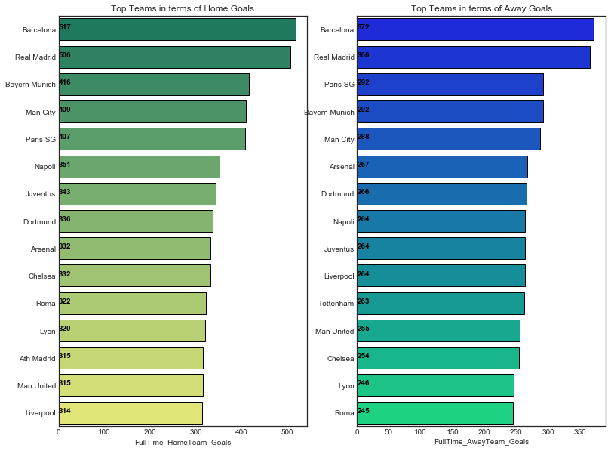
Feature analysis – Top teams and Goals
These two lists have a lot of teams in common. This indicates that good teams usually do well at home as well as away (However they score better at home than at away).

Slide 18
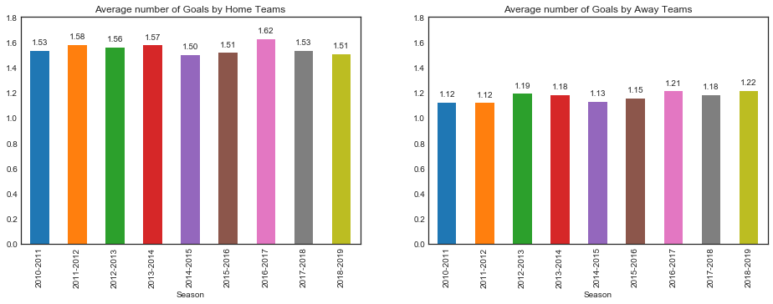
Feature analysis – Over the year performance
Over 10 years, away team have marginally improved from 1.12 goals to 1.22 goals per match.

Slide 19
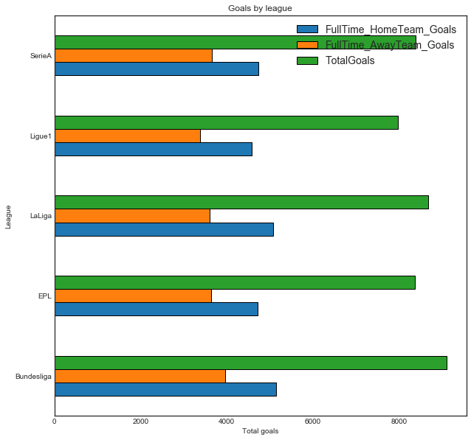
Feature analysis – Total goals for all seasons
Ligue One produces less goals as compared to other leagues. Post adjustment, Bundesliga produces more goals than any other leagues.

Slide 20
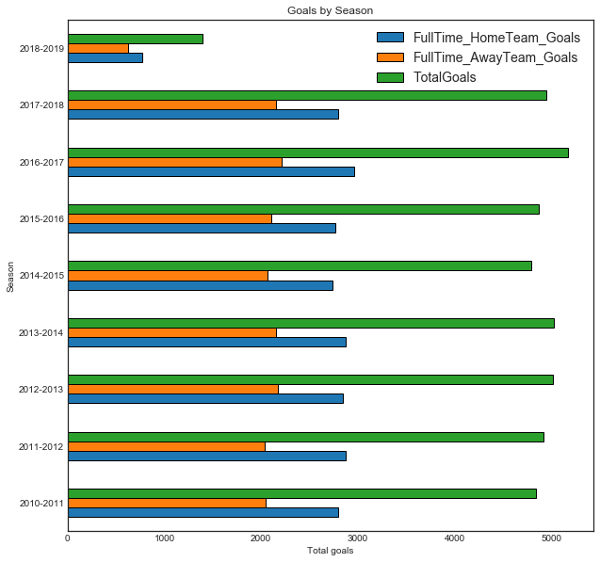
Feature analysis – Season wise goals
From 2010-11 to 2013-14, number of goals increased each season but stopped growing after 2013-14 season (except for a spike in 2016-17)

Slide 21
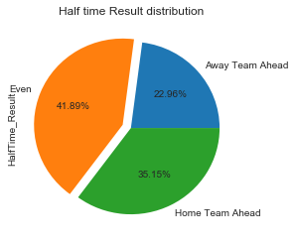
Feature analysis – Half time result
Home team has advantage right from the beginning.

Slide 22
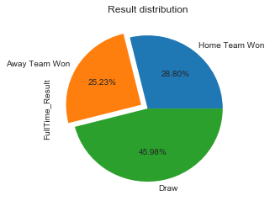
Feature analysis – Full time result
Home team advantage fell marginally but still overall result favors home team

Slide 23
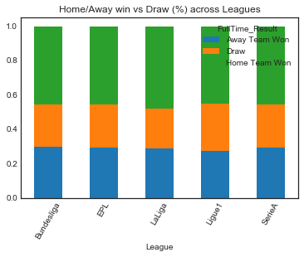
Feature analysis – Result variation across leagues
Home team wins more than 40% of matches in every league.
Home advantage seems to be more prevalent in La Liga.
Ligue1 produces more draws than other leagues.

Slide 24
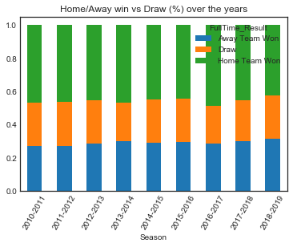
Feature analysis – Result variation across seasons
No significant change.
Home advantage seen across all seasons.
Away teams’ performance improved marginally.

Slide 25
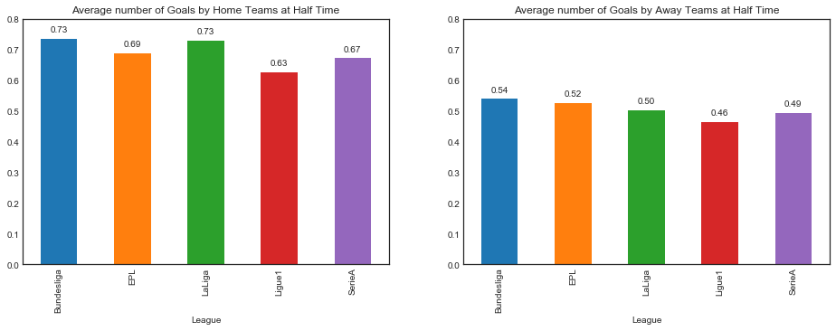
Feature analysis – Half time goals
Home team dominates from the beginning of the match
Home advantage is clear here

Slide 26
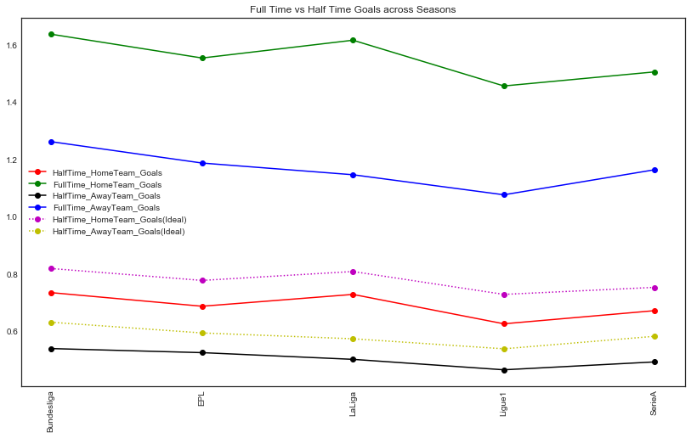
Feature analysis – Full time vs Half time goals by League
For both Home teams and Away teams, half time goals is significantly less than full time goals.
Both Home and Away teams aggressive during the second half of the match

Slide 27
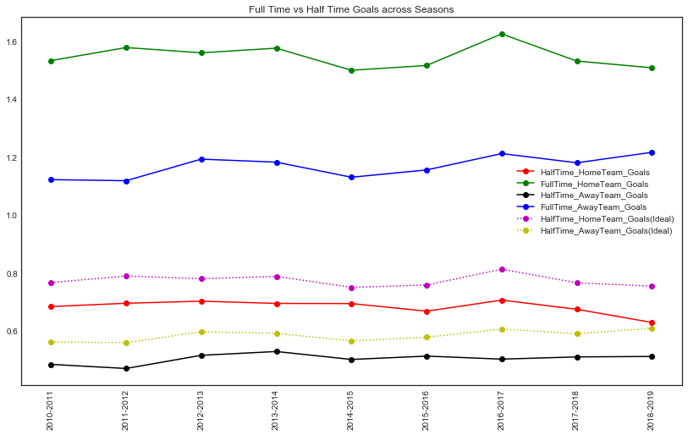
Feature analysis – Full time vs Half time goals by Season
Over the years, both home and away teams have remained defensive during the first half of a match and became aggressive during the second half.

Slide 28
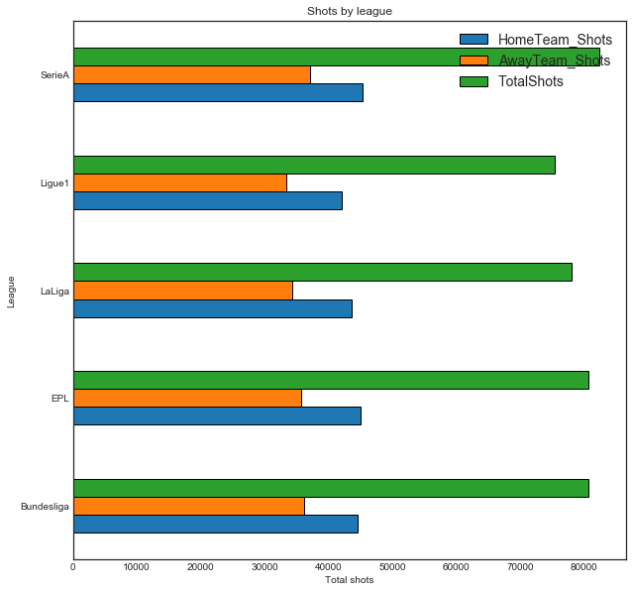
Feature analysis – Shots across all seasons
Serie A, Bundesliga (adjusted) and EPL has max number of shots at goal per season.
Interestingly, La Liga leads in number of goals per season but not at number of shots whereas it is other way round for Serie A
So, we can conclude that La Liga forwards are more accurate in general as compared to Serie A forwards

Slide 29
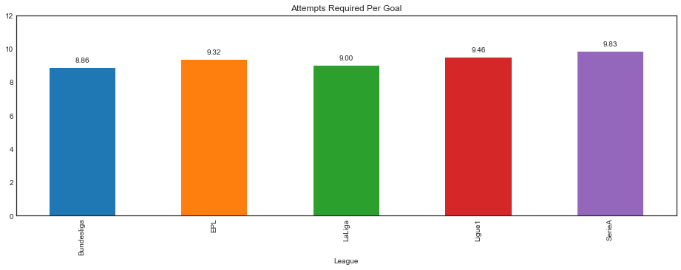
Feature analysis – Attempts per goal
Forwards in Bundesliga and LaLiga are more accurate as compared to others. Forwards in SerieA are the least effective

Slide 30
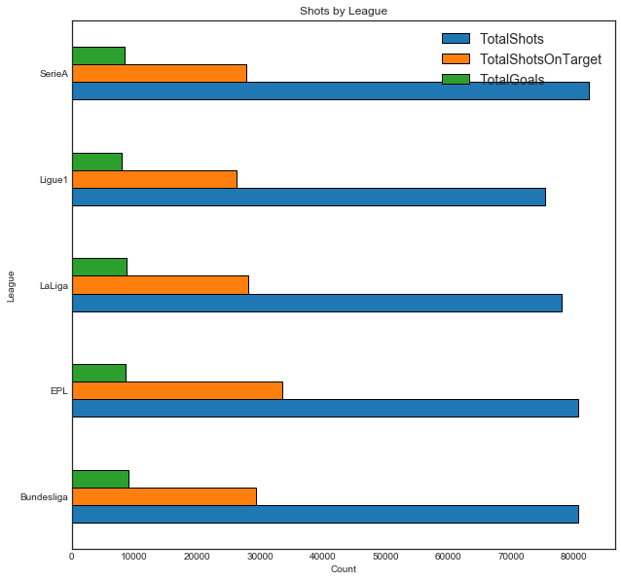
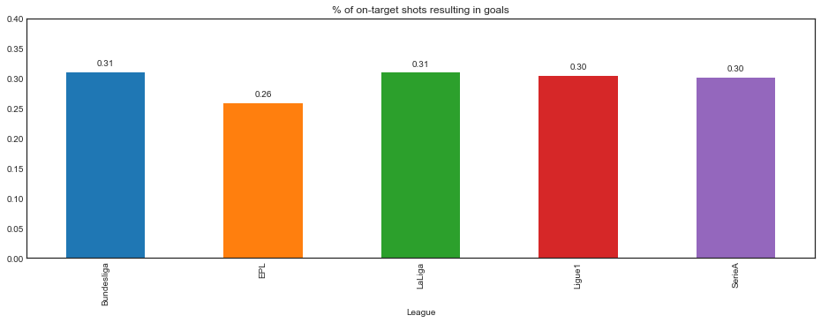
Feature analysis – Shots on target and yield
Even though EPL has more number of shots on target, its yield is the least.

Slide 31
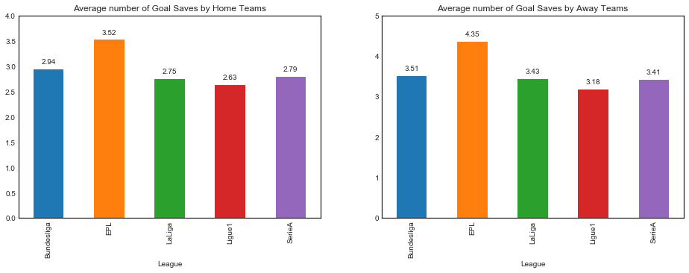
Feature analysis – Goals saved
Interestingly Away teams save more goals than home team in almost every league. But that might also be because home teams usually are more effective with number of shots on target. EPL probably keeps goalkeepers busier than other leagues

Slide 32
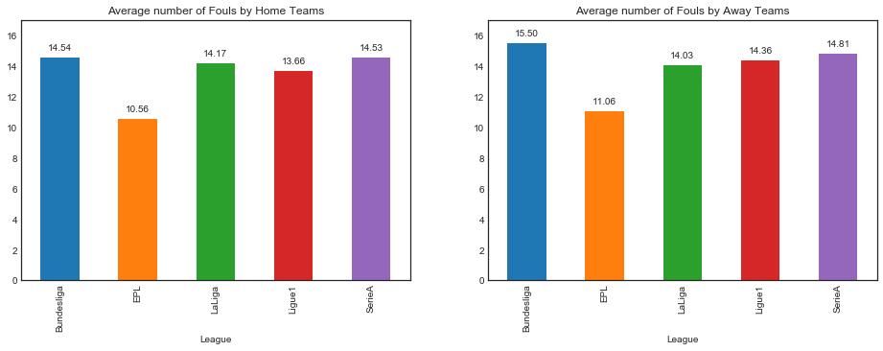
Feature analysis – Fouls
EPL is apparently the most disciplined league.
BundesLiga has highest number of fouls but that could be because it was scaled up.

Slide 33
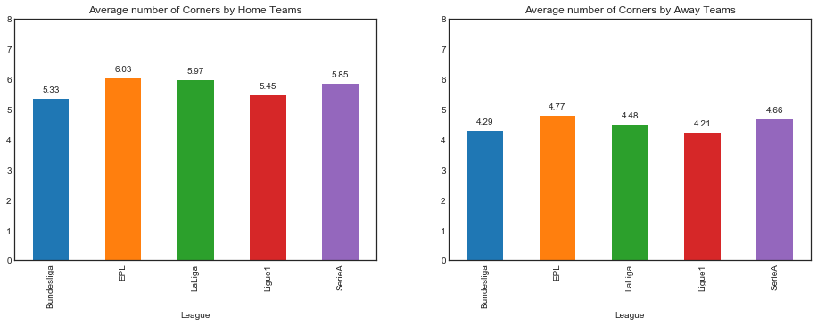
Feature analysis – Corners
Home team is awarded with most corners. This aligns with number of shots on target.
This also indicates home team is more aggressive.

Slide 34
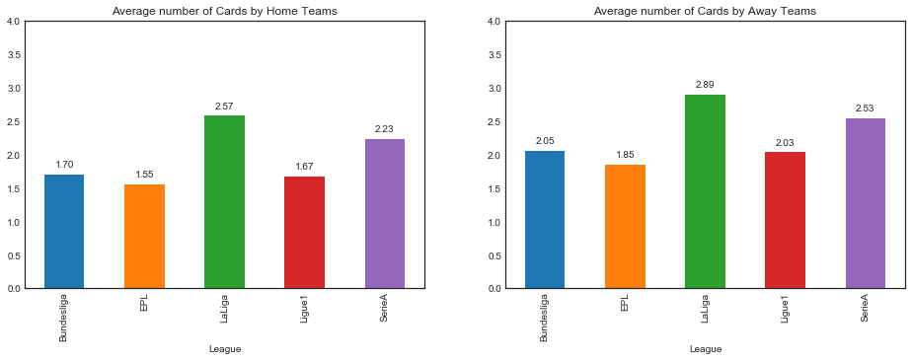
Feature analysis – Red/Yellow cards
Away team faces more red/yellow cards showing that they become aggressive to catch up.

Slide 35
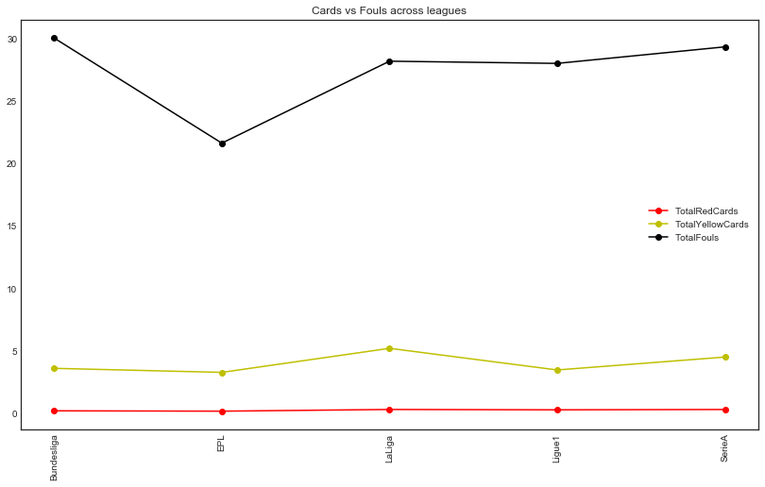
Feature analysis – Correlation between cards and fouls
Except in EPL, there seems to be a linear correlation between number of cards and number of fouls

Slide 36
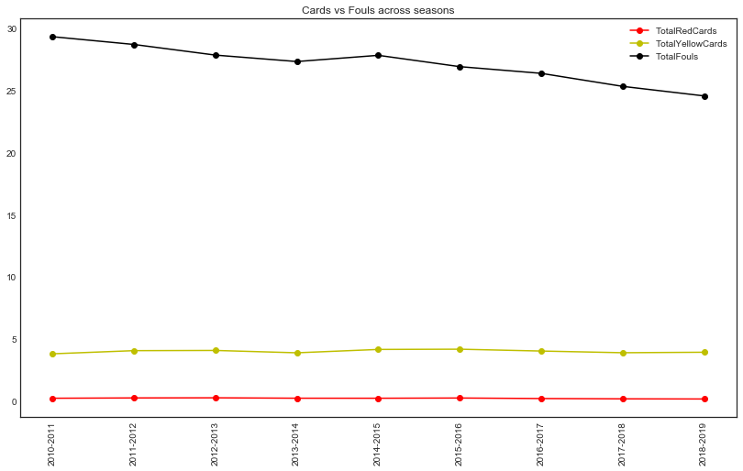
Feature analysis – Fouls and cards trend
Average number of fouls per game has come down significantly however the average number of cards haven't changed much. This indicates that referees have become more strict over the years

Slide 37
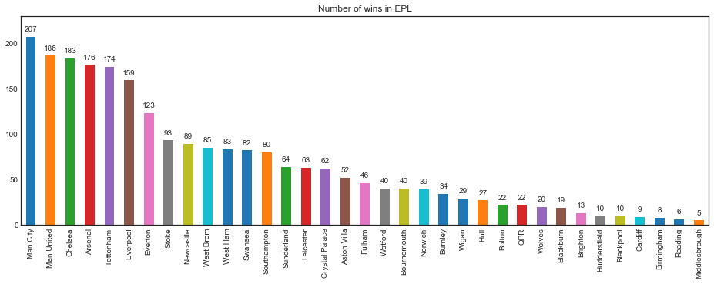
Feature analysis – Winning teams- EPL

Slide 38
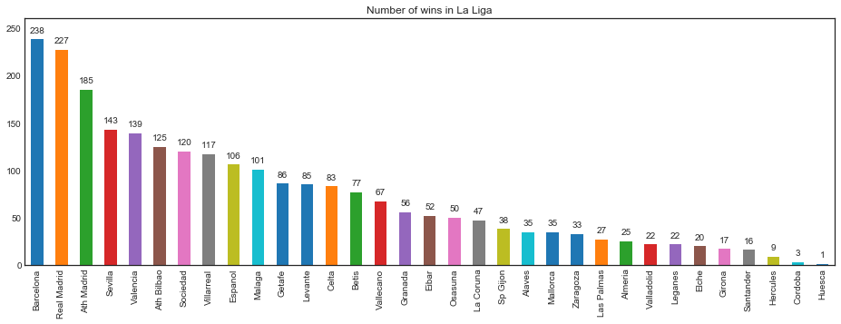
Feature analysis – Winning teams- La Liga

Slide 39
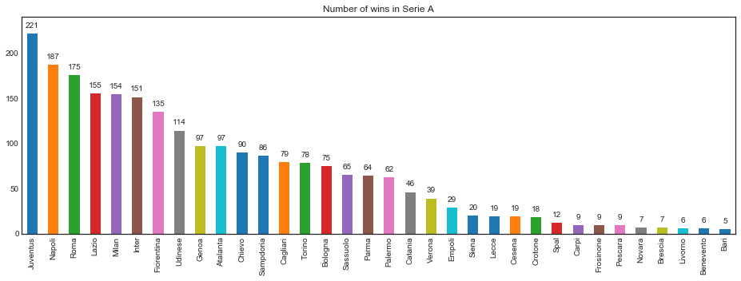
Feature analysis – Winning teams- Serie A

Slide 40
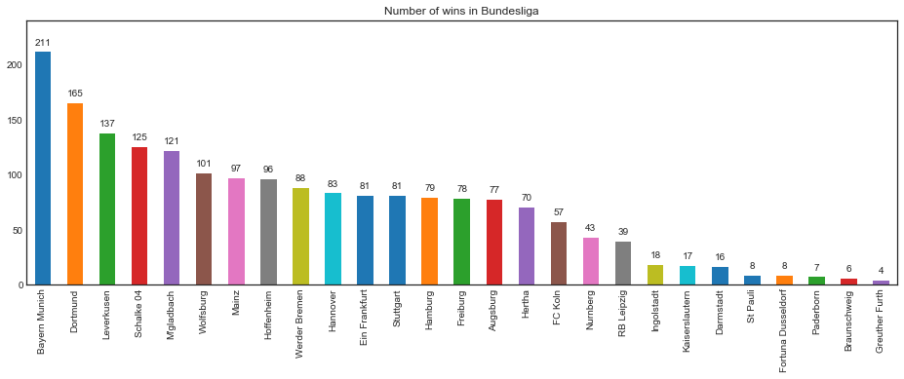
Feature analysis – Winning teams- BundesLiga

Slide 41
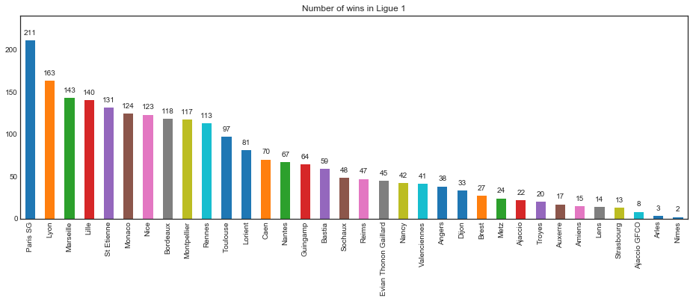
Feature analysis – Winning teams- Ligue1

Slide 42
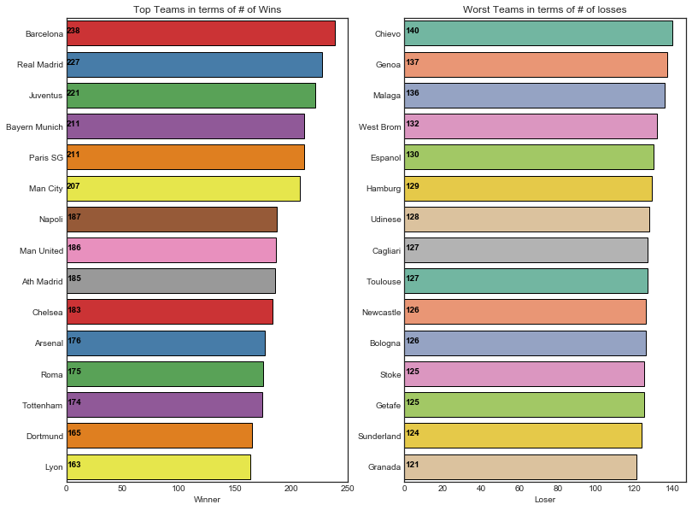
Feature analysis – Top and bottom 15
Two La Liga giants- Barcelona and Real Madrid have won the maximum number of matches in last 9 seasons

Slide 43
Feature analysis – Conclusion
EPL is the most volatile league in terms of league qualification. Only 35 % of teams have been consistently present in last 10 years
There's a significant home advantage in every league. Away performance is improving in general but not at a very rapid pace
EPL and LaLiga produces more goals compared to other leagues
Both Home and Away teams produce more goals during second half
Forwards in La Liga and Bundesliga are the most effective. Forwards in Serie A are the least effective
EPL clearly is the most disciplined and least violent league with least number of fouls and cards. La Liga leads in number of red and yellow cards
Average number of fouls have fallen across all leagues over last 10 years. However average number of cards haven't
EPL forwards land maximum number of shots on target. However, EPL goalkeepers save maximum number of goals as well

Slide 44
Match Outcome Feature Analysis
What features affect the outcome of a game?
Shots?
Fouls? Red Cards? Corners?
Does those feature change over seasons?
This analysis focused on the feature on winners
What features make a team to won the Champion?
Home Goals?
Away Goals?
Cards and Fouls?

Slide 45
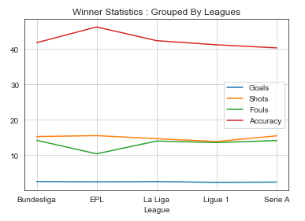
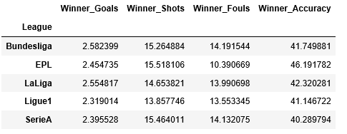
Match Outcome Feature Analysis
The average winner goal is similar for different league
The EPL winner has the highest accuracy, and least fouls.

Slide 46
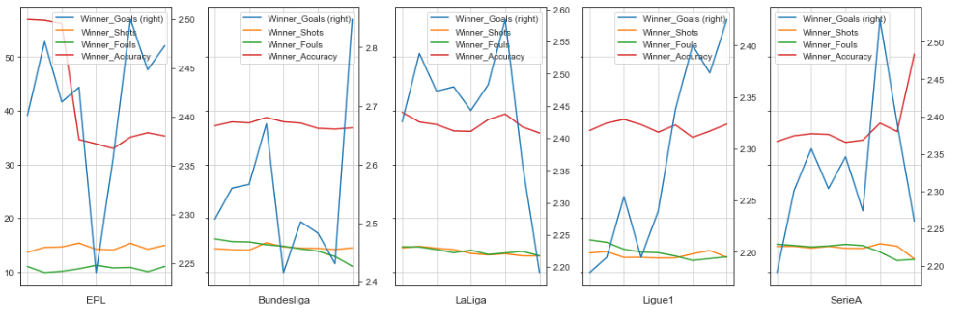
Match Outcome Feature Analysis
Notes:
Break down by seasons for each league to see any changes in feature.
EPL accuracy dropped significantly, in contrast, Serie A accuracy increased a lot.
Number of fouls dropped consistently for all leagues except EPL.
Winner’s average goal fluctuated across seasons. Ligue 1 winner’s goal improved a lot.

Slide 47
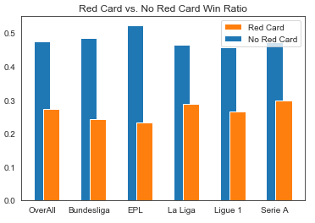
Match Outcome Feature Analysis
Generally, the team without red card will have much higher chance to win compare to the team with a red card
This is true for all 5 leagues, especially EPL. This may indicated EPL has higher competition.

Slide 48
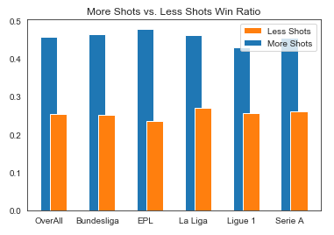
Match Outcome Feature Analysis
Generally, the team with more shots will have higher chance to win the game
This is true for all 5 leagues, especially EPL.

Slide 49
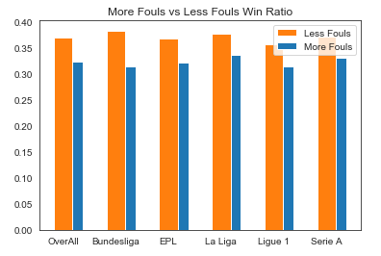
Match Outcome Feature Analysis
The team with less fouls will high chance to win the game. However, the difference is small.

Slide 50
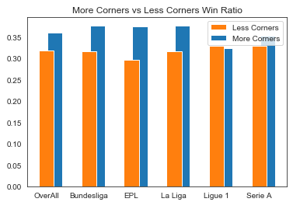
Match Outcome Feature Analysis
The team with more corners will high chance to win the game. However, the difference is small.
This is not true for Ligue 1.

Slide 51
Match Outcome Feature Analysis Summary
Team will have higher chance to win the game if they have following features:
more shots
no red card
less fouls
more corners

Slide 52
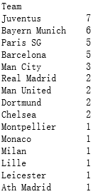
Champion Feature Analysis
Determine the Champion for each league for each season
Rules:
Win : 3 points
Draw : 1 point
Lose : 0 point
The team with highest accumulative points win the season
Juventus dominates Serie A wins 7 times since 2010.
Bayern Munich dominates Bundesliga wins 6 times.
Paris SG and Barcelona 5 times.
Only EPL doesn’t have a team dominates the league.

Slide 53
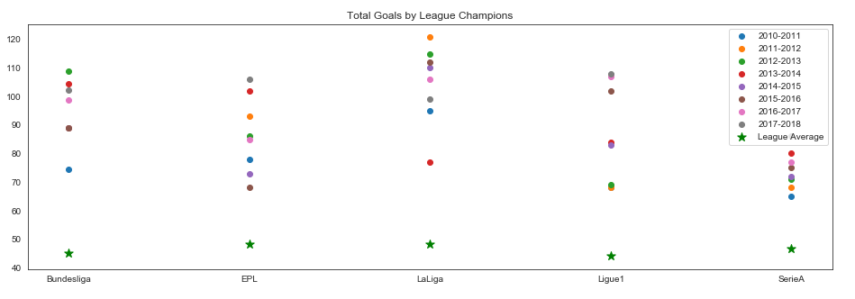
Match Outcome Feature Analysis

Slide 54
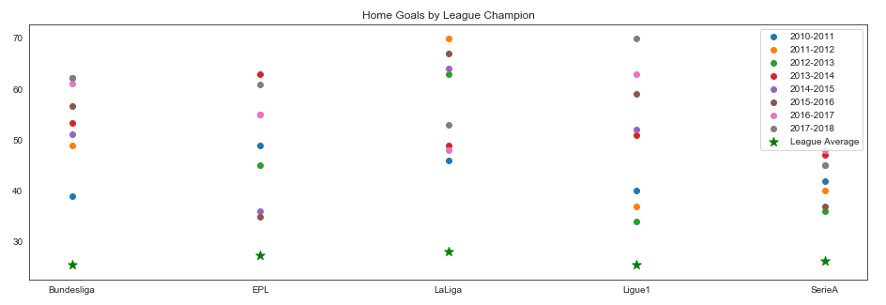
Match Outcome Feature Analysis

Slide 55
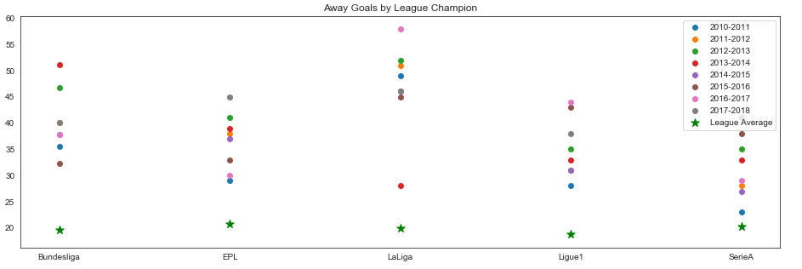
Match Outcome Feature Analysis

Slide 56

Match Outcome Feature Analysis

Slide 57

Match Outcome Feature Analysis

Slide 58

Match Outcome Feature Analysis

Slide 59

Match Outcome Feature Analysis

Slide 60
Match Outcome Feature Analysis Summary
Champions will have significantly more goals comparing the league average.
Champion will have more goals at home games comparing to away games.
Number of fouls and red card is similar to league champion and other teams.
Comparison across leagues:
Serie A has the lease goal for champions and the lowest goal efficiency. Italian team tend to have better defence, this could be one of the reason.
La Liga has the largest gap between champion and league average on goals. La Liga also has the biggest dominance in the home game goal.
EPL’s champion has the least fouls committed.

Slide 61

Event Analysis
We are using a secondary dataset to analyze events, individual performances and relationship between betting odds and actual match results
Each row of this dataset corresponds to an event during a soccer match – overall the dataset has information for almost a million events
Some examples of events are : Foul, Goal Scored, Goal Blocked, Substitution, Offside, Handball, Penalty etc.

Slide 62





Event Analysis
So the top 3 events in every league are Free kick won, Fouls and Attempts
EPL produces half the number of fouls as compared to La Liga despite the fact that both leagues involve same number of matches

Slide 63

Event Analysis: Where to aim in order to score a goal ?
Here’s what goal data for last 6 years reveal :
Data clearly suggests that most of the goals come off shots aimed at the bottom left or right corner

Slide 64

Which teams and individuals are the most prolific scorers ?
Lets look at the team level data first
The La Liga giants – Barcelona and Real Madrid are at the top. Bayern Munich is at no 3 with 453 and even if we apply adjustments for La Liga, falls way shot of top 2 at 506. Interestingly none of the EPL teams made it to the list of top 10 goal scorers

Slide 65

Which teams and individuals are the most prolific scorers ?
No surprises there at top 2. Zlatan Ibrahimović is the only player to make it to this list after playing in three different leagues (Serie A, Ligue One, EPL) during this period. Also since he plays for LA Galaxy now, his 2018-19 season data isn’t included here. So he is much closer to no 2 than what the data suggests

Slide 66


But what about the number of goal attempts missed ?
The top 3 in terms of number of attempts missed are also the same trio of Ronaldo, Messi and Zlatan
Again the usual suspects at top 3 – clearly they create the most number of chances and hence score the most as well as miss the most
Cristiano Ronaldo has almost a 20 % lead over Lionel Messi in terms of number of terms

Slide 67

What about efficiency at scoring goals ?
Cristiano Ronaldo and Lionel Messi are considered among greatest of all times because they have been consistently creating chances.
Their teammates like Suarez and Higuain have better attempt-to-goal-conversion-rate but doesn’t create half as many chances as Messi and Ronaldo

Slide 68

Which individuals produce the most number of goal assists ?
Cristiano Ronaldo tops the number of assists as well (and is ahead of Messi at no 2 by nearly 30 %)
Two of Ronaldo’s teammates make it to the list as well – Benzema and Higuain. None of Messi’s Barcelona teammates make it to this list
Ronaldo, Messi and Zlatan are clearly the top 3 forwards from the last 6 years

Slide 69

Defense yardsticks – number of fouls and cards
More fouls are committed by lower ranked teams in the league.
Lyon and Lazio are the only top tier teams with very high number of fouls

Slide 70


Defense yardsticks – number of fouls and cards
Surprising to see an attacking midfielder like Paul Pogba in this list. Equally surprising to see not see Sergio Ramos in this list
Not many players made it to both the lists.
Gabi from Athletico Madrid is among the worst offenders - he features in top 3 in terms of both the number of fouls committed as well as the number of cards

Slide 71

Building a player comparator function

Slide 72

Building a player comparator – sample input and output
Sample Usage :
cmp = player_comparator(events, ['lionel messi','cristiano ronaldo','zlatan ibrahimovic','gonzalo higuain’, 'luis suarez','karim benzema','gareth bale', 'harry kane','neymar'])
display(HTML(cmp.to_html()))
Output:

Slide 73

When are the most goals scored during a football match ?
Interestingly there's a massive spike in number of goals just before half time and full time for both home and away teams

Slide 74

When do most player substitutions occur ?
Just like goal data, there's a massive spike in number of substitutions just around half time and full time.

Slide 75

When are the most number of red and yellow cards shown in a football match ?
There's a spike in number of yellow cards just before half time and full time.
Most red cards are shown in last few minutes of a match (possibly when opponent is trailing by a goal and desperate to score and thus, the stakes are high)

Slide 76


The early goal scorers
For our analysis, we are considering a goal scored during first 10 minutes of a game as an early goal
There are very matches where a team scores a goal in first 10 minutes
Finally we have some statistical yardstick for forwards which isn’t led by Ronaldo or Messi or Zlatan
Interestingly 3 out of top 15 early goal scorers are from Real Madrid
Real Madrid leads the early goal scorer table at club level

Slide 77


The last minute goal scorers
For our analysis, we are considering a goal scored after 85th minute of a game as a early goal
The forward trio are back in business again

Slide 78

Which league is the most competitive ?
Leagues that are normally distributed are less competitive because the best and worst teams are equidistant from the mean
Left skewed distribution means only a few handful teams are close to the top whereas right skewed distribution means there's lot of competition at the top
From the plot it seems that La Liga and Bundesliga are the most competitive

Slide 79





Betting odds – are they indicative of results ?

Slide 80
Betting odds – are they indicative of results ?
For every match we have 3 columns for betting odds : home_odds, away_odds and draw_odds
The odds are expressed as numeric values (e.g a betting odd of 4 means, you’ll win $ 400 for every $ 100 that you bet
From the odds, the probability of the event (as per bookies) can be calculated as :
P = 1/1 + odd
So, a betting odd of 4 will translate to a probability of 0.2
We converted the betting odd numbers into predicted outcome (lower odds = more likely outcome) and tried to find a correlation between the predicted and the actual outcome
Clearly betting odds have some correlation with actual results but aren’t exactly indicative of results
Moral of the story : It’s probably not a sustainable idea to get rich by betting on football matches.
 | EPL | LaLiga | Serie A | Bundesliga | Ligue One
Home Win | 0.27 | 0.3 | 0.29 | 0.21 | 0.25
Away Win | 0.31 | 0.29 | 0.35 | 0.22 | 0.29
Draw | -0.12 | -0.11 | -0.07 | -0.1 | -0.04

Slide 81

Predictive Modelling of Number of Goals
Statistical studies on goal scoring pattern in football matches often suggest that goals in a football match follow Poisson distribution pattern.
We continued with that assumption and use the mean expected number of goals for a match to form a probability distribution and express the number of goals as a function of average rate of scoring goals

Slide 82

Match simulation – Man City vs Man Utd at Etihad Stadium
Prediction by Model :
Probability Man City Win (Man City Home) : 0.5213758840709862
Probability Man U win (Man City Home) : 0.237715360715005
Probability Draw (Man City Home) 0.2409069842947822
Actual Results :

Slide 83

Match simulation –FC Barcelona vs Real Madrid at Camp Nou
Prediction by Model :
Probability Barcelona Win (Barcelona) : 0.6127844341417124
Probability Madrid win (Barcelona) : 0.20240895399328018
Probability Draw (Barcelona) 0.18475050565145482
Actual Results :

Slide 84
Football Data Analysis
Thank You

